Slide 1
Healthcare Data Management System: A Comprehensive Analysis

Slide 2
agenda
Introduction
Building confidence
Engaging the audience
Visual aids
Final tips & takeaways

Slide 3
Introduction
Easy and secure patient data access requires healthcare data management. In the EHR era, effective data management improves healthcare. Data interoperability, patient involvement, and scalable infrastructure are addressed by this initiative. We aspire to reinvent healthcare information management by establishing a complete Healthcare Data Management System to provide a smooth experience for patients and professionals. The healthcare industry's changing demands need sophisticated data management solutions, which this project emphasizes.

Slide 4
Relevance and Importance
Enhanced Accessibility: Digital transformation in healthcare improves patient record access, allowing doctors to make faster, more informed choices.
Interoperability: Digital technologies enable healthcare organisations to communicate and share data, boosting interoperability and efficiency.
Patient-Centric Care: Digital transformation emphasizes patient participation by providing access to personal health data and contact with healthcare professionals.
Data-Driven Decision Making: Digital technologies provide healthcare workers data analytics capabilities to enhance diagnosis, treatment planning, and results.
Effectiveness and Cost Savings: Automated processes and electronic health records decrease administrative loads, mistakes, and costs, improving healthcare delivery efficiency.

Slide 5
Problem Statement
Data Silos: Healthcare data is fragmented among systems and departments, preventing a complete patient health history.
Lack of Standardization: Data formats and standards vary, preventing healthcare systems from sharing data.
Limited Patient Engagement: Traditional healthcare systems fail to engage patients, resulting in low care management engagement.
Security Issues: With healthcare cyberattacks on the rise, protecting patient data is difficult.
Scalability Issues: Healthcare data volumes are expanding fast, making it difficult to develop systems that can effectively scale to accommodate the growing quantity of data.

Slide 6
Previous and Current Work, Methods, and Procedures
Legacy Systems: Healthcare organizations may use outdated systems that lack sophisticated functionality for data management and interoperability.
Proprietary Solutions: Closed solutions restrict system interoperability and healthcare data flow.
Fragmented Standards: Healthcare data formats vary, making it difficult to link systems and communicate information.
Patient Portal Concerns: Usability concerns hinder patient portals' capacity to engage and empower people in their healthcare journey.
Insufficient Interoperability: Despite attempts, many existing systems lack real interoperability, preventing healthcare groups from exchanging data efficiently.

Slide 7
Relevant Studies, Methodologies, and Systems:
Interoperability Frameworks: Studies stress the need of using HL7 and FHIR to facilitate smooth healthcare system communication.
Blockchain in Healthcare: New research examines how blockchain technology might improve healthcare data integrity and security by enabling safe and transparent transactions.
Data Governance Models: The requirement for defined rules, standards, and responsibilities to assure data quality and security is a repeating subject in data governance frameworks.
Patient-Centric Approaches: Recent techniques emphasize patient-centric approaches, which emphasize patient participation in health information management via user-friendly interfaces and portals.
AI and Predictive Analytics: Literature studies illustrate how healthcare data management is integrating AI and predictive analytics to improve decision support systems and patient outcomes.

Slide 8
Methodology
We used Agile to design our Healthcare Data Management System to respond to changing needs. Agile principles allowed the development team, healthcare experts, and stakeholders to collaborate and provide input throughout the iterative development process. User stories made the system user-centric, meeting healthcare practitioners' and patients' demands.
We secured patient data using industry-standard database management solutions. The system architecture uses HL7 and FHIR standards for interoperability and smooth interaction with other healthcare systems. Modern programming languages and frameworks were used to design a scalable and resilient solution to manage growing healthcare data volumes.
The development lifecycle included a continuous integration and continuous deployment (CI/CD) pipeline to effectively provide updates and upgrades to end-users. This technique enabled a dynamic and flexible development process that addressed difficulties quickly and ensured the Healthcare Data Management System met the highest functionality, security, and user experience criteria.

Slide 9
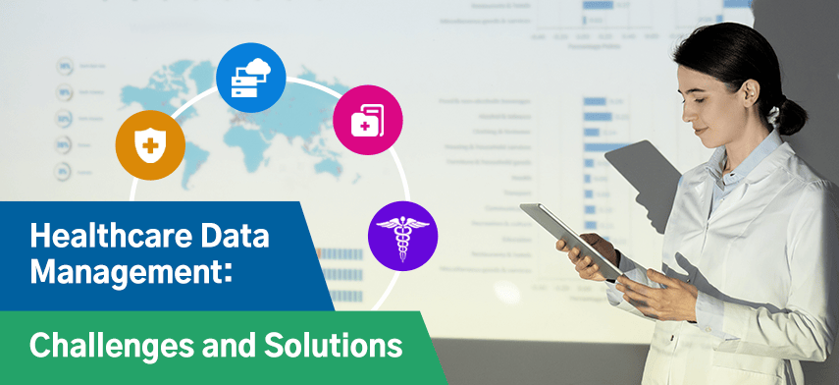
implementation
Our Healthcare Data Management System meets current healthcare data needs with a strong and scalable architecture. The system architecture incorporates a modular design for future expansions and upgrades and a centralized database for safe EHR storage. Deployment diagrams show server distribution for best performance and redundancy.

Slide 10
Key Features
Interoperability: HL7 and FHIR standards provide smooth integration and data sharing with various healthcare systems, creating a unified healthcare ecosystem.
User-Friendly Patient Portal: A user-friendly patient portal lets patients access their health information, connect with doctors, and participate in their treatment plans.
Clinical Decision Support Algorithms: Advanced algorithms help healthcare practitioners make diagnostic and therapeutic decisions.
Data Analysis and Reporting: The system's powerful reporting and data analysis features enable healthcare practitioners to discover patterns, follow results, and make educated choices based on complete data insights.
Scalability: The system is built to manage growing user traffic and data quantities, assuring optimum performance as the healthcare data environment advances.

Slide 11
Results and Discussion
Successful System Deployment: The Healthcare Data Management System was successfully implemented, giving healthcare professionals and patients a safe and accessible platform for managing electronic health information.
Interoperability Achievement: Integrating HL7 and FHIR standards made data interchange seamless, overcoming fragmented standards and improving healthcare system interoperability.
Positive User Feedback: The user-friendly patient portal received favorable reviews from healthcare practitioners and patients. The user-friendly design boosted patient involvement and healthcare professional communication.
Clinical Decision Support Impact: Clinical decision support algorithms helped healthcare workers make better decisions and diagnose better.
Verification of Scalability: The system handled increasing user traffic and data quantities well. This scalability allows the Healthcare Data Management System to respond to changing healthcare data.

Slide 12
conclusion
The Healthcare Data Management System produced in this project is a major healthcare technology innovation. The initiative overcame data interoperability, patient engagement, and scalable infrastructure issues. The system improves healthcare data management by offering a complete solution. Patient care has improved because to a user-friendly patient portal and clinical decision support algorithms that empower patients and healthcare providers. HL7 and FHIR standards promote interoperability, solidifying the system's role in connecting and collaborating healthcare. The system's scalability and agility show it can manage dynamic healthcare data. This solves present issues and offers the project as a forward-thinking solution that can meet healthcare sector objectives. This project offers a paradigm to simplify operations, enhance patient outcomes, and improve healthcare data management efficiency and security. The system is a lighthouse for the digital transformation of healthcare, showing how technology can modify data practices and improve healthcare delivery.

Slide 13
Future Developments
Advanced Analytics and Predictive Modeling: Advanced data analytics and predictive modeling might improve the system's analytical capabilities. This would help healthcare practitioners identify patterns, predict health concerns, and customize treatment strategies.
Blockchain Integration for Security: Blockchain technology might improve healthcare data security. Decentralized and tamper-resistant blockchain may add confidence to medical records, assuring privacy and immutability.
Telehealth functions: As telehealth becomes more important, the system may be expanded to smoothly include telehealth functions. This would allow virtual consultations, remote monitoring, and better patient-provider communication.
Wearable Technology Integration: Wearable device data for continuous health monitoring is promising. Wearable technology and the Healthcare Data Management System may give real-time health data for more complete and proactive patient treatment.
Global Health System Interoperability: To genuinely globalize healthcare data interchange, future advances may improve local and international interoperability. Aligning with global healthcare standards and enabling safe cross-border data exchange might transform global healthcare collaboration.

Slide 14
Thank you

